Slide 1

Project: To model the CO2 emissions as a function of several car engines features.
Date: 08-04-2024 By Group: 4

Slide 2
Team members:
1)Aditya Awad
2)Anuja Sasane
3)Bala Ram
4)Deeksha
5)Manu k
6)Gaurav Choudhari
7)Suchetha D H

Slide 3
Objectives
Carbon dioxide emission prediction involves several variables, each serving a specific purpose in prediction of it. Here are some variables which helps in prediction:
1)make, car brand under study.
2)model, the specific model of the car.
3)vehicle_class, car body type of the car.
4)engine_size, size of the car engine, in Litres.
5)cylinders, number of cylinders.

Slide 4
Libraries Used:
Pandas
Matplotlib
Seaborn
Sklearn
numpy

Slide 5
Project Work involves:
1.Analyze the data
2.Cleaning the data(EDA)
3.Data Visualization and Feature Engineering
4.Building different models
5.Model Deployment

Slide 6
Exploratory Data Analysis (EDA) is a crucial step in predicting carbon dioxide emission prediction as it helps understand the underlying patterns, trends, and relationships within the data.
1. Analyse the data: Calculate summary statistics such as mean, median, standard deviation, minimum, maximum, and quartiles to understand the central tendency, variability, and distribution of data.
2. Cleaning data: Looking for null and duplicated values in data, if found the null and duplicated values are treated and looking for outliers in the data and id found are treated to get the cleaned data and Correlation Analysis: Examine the correlation between different relevant variables such as: Use correlation matrices, scatter plots, or heat maps to visualize and quantify the relationships and feature engineering is also done to get best 30 features for better model building.

Slide 7
3.Data Visualization: Examine the distribution of different variables to assess their normality or identify potential skewness and kurtosis. Use histograms, pie chart to visualize the distribution and compare it with theoretical distributions like the normal distribution.
4.Building different model: Based on insights gained from EDA, identify potential models or forecasting techniques that are suitable for modeling carbon dioxide emission prediction. Consider factors such as distribution of data and the relationship with relevant variables.
5.Model Deployment: Deployment of suitable model which gives best accuracy for unseen data prediction is done using and the model gets deployed.

Slide 8
Models used in Prediction of Carbondioxide emission Prediction:
Decision Tree Regressor
Adaboost Regressor
Random Forest Regressor
Gradient Boost Regressor
Neural Network
KNN

Slide 9
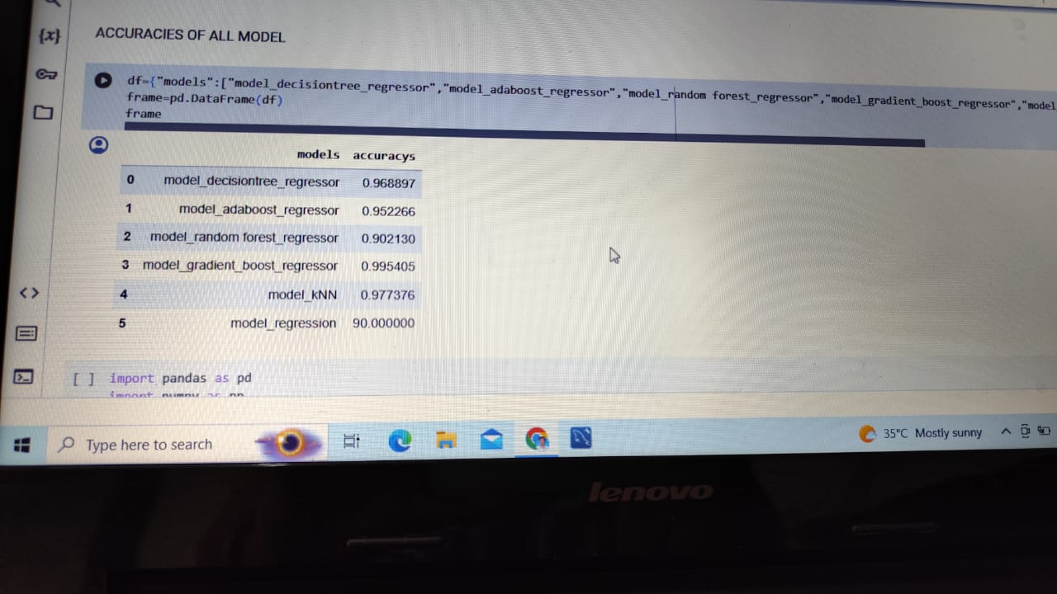
Training Accuracies of all models tried:

Slide 10
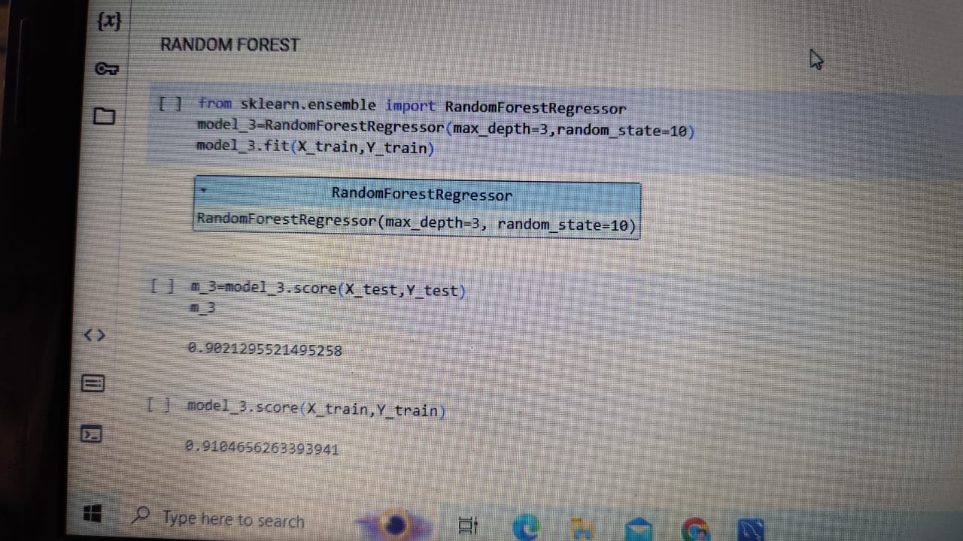
Testing and Training Accuracy of Random Forest Regressor:

Slide 11
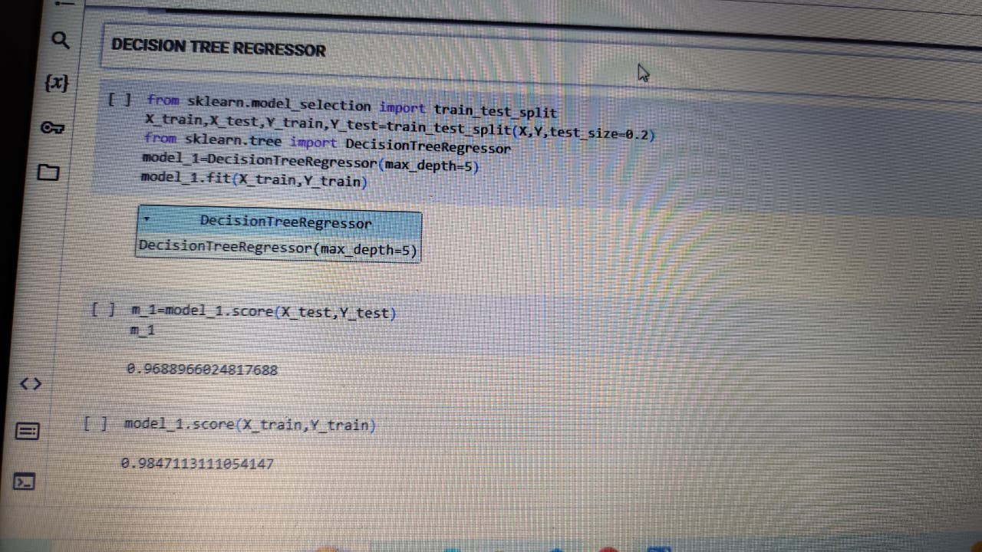
Testing and Training Accuracy of Decision Tree Regressor :

Slide 12
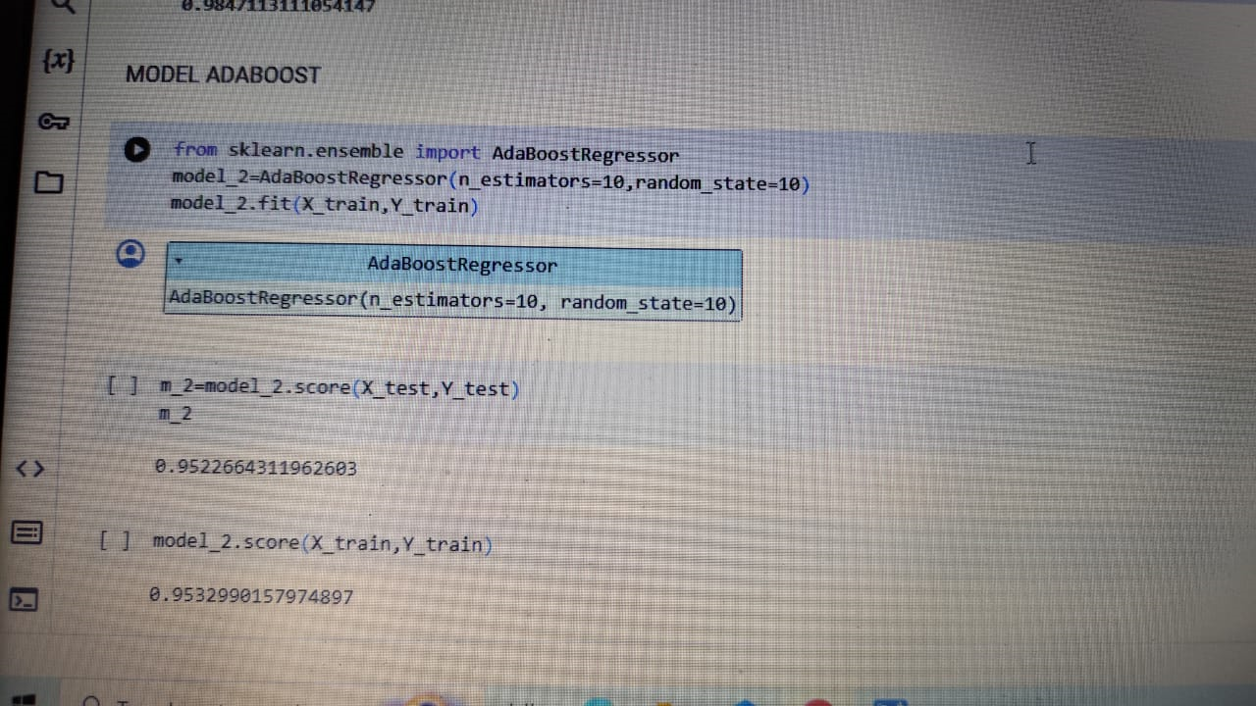
Testing and Training Accuracy of Adaboost Regressor :

Slide 13
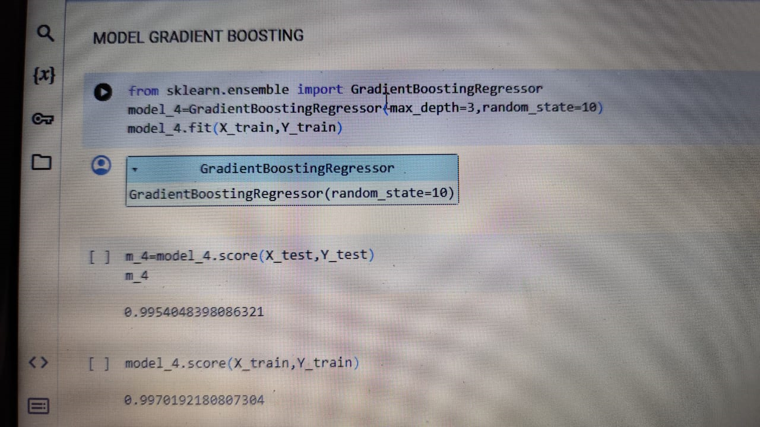
Testing and Training Accuracy of Gradient Boost Regressor:

Slide 14
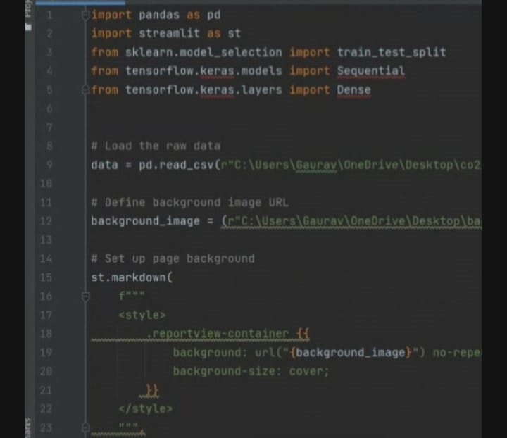
Neural Network Model Deployment:

Slide 15
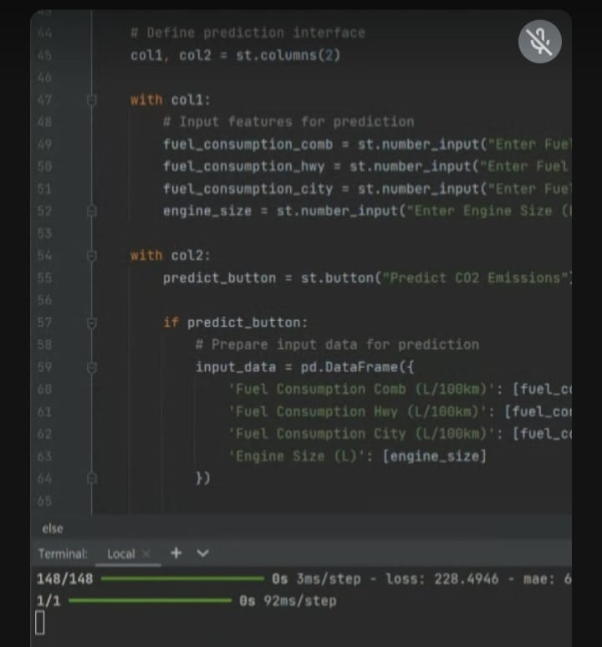
Neural Network Model Deployment:

Slide 16
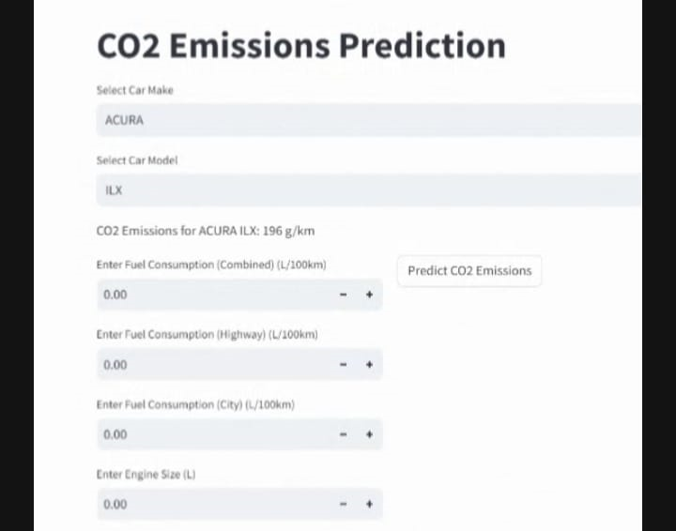
Neural Network Model Deployed on Emission prediction app:

Slide 17
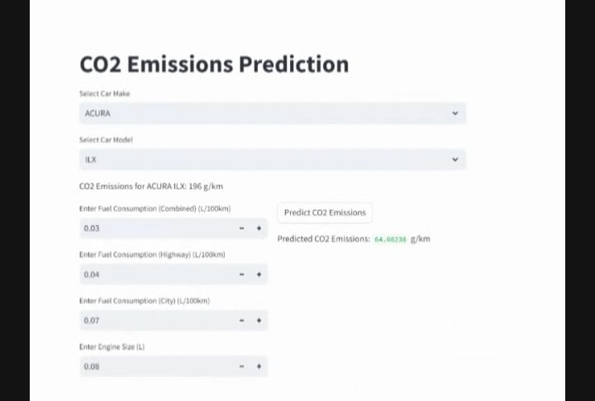
Neural Network Model Deployed for customized input data:

Slide 18
Challenges faced:
To find variables which are affecting the independent variable.
The training and testing accuracy for different models were tried out and analyzed thoroughly to select best model for deployment.

Slide 19
Overcoming the Challenges:
1) We overcame these challenges by analyzing correlation matrix.
2) Best model for deployment is finalized after thorough discussion.

Slide 20
THANK YOU.

